Slide 1

Gradient descent — now with extra learning power!
Hero: Abby the Robot with Mistake-Sensing Superpowers!
Target Audience: 11 year old kids

Slide 2
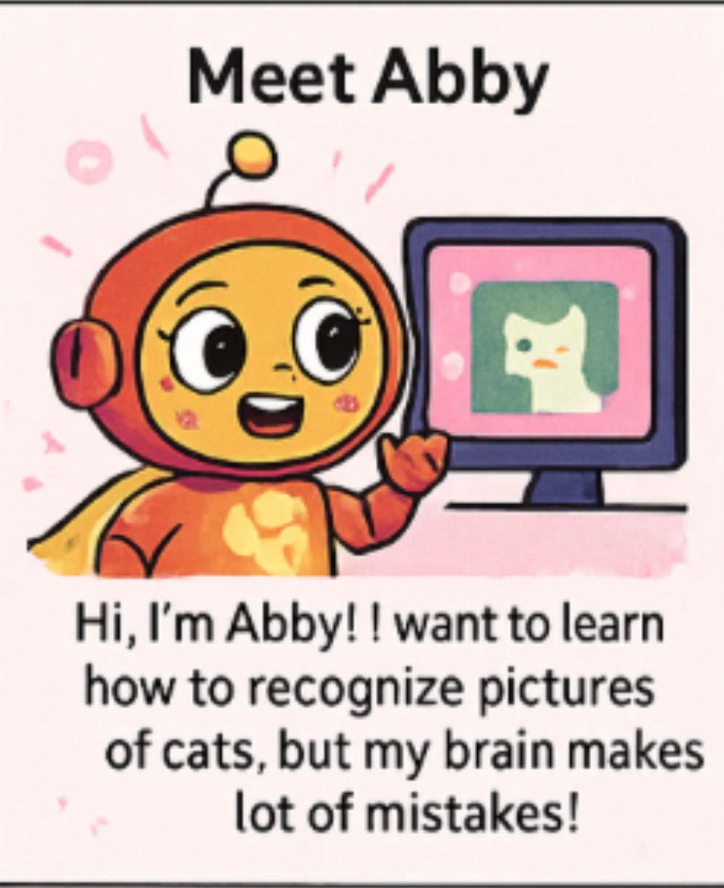
Meet Abby-Our Learning robot!
Text: Hi! I’m Abby, and I want to learn how to spot cats in pictures. But my brain is full of wires and guesses….and lots of mistakes! Luckily, I have a superpower, which is called Mistake Sparks, every time I’m wrong, I see sparks that show me where and how bad the mistake is!
Concept Introduced: Neural Networks try to learn by making guesses and seeing how wrong they are (error/loss).

Slide 3
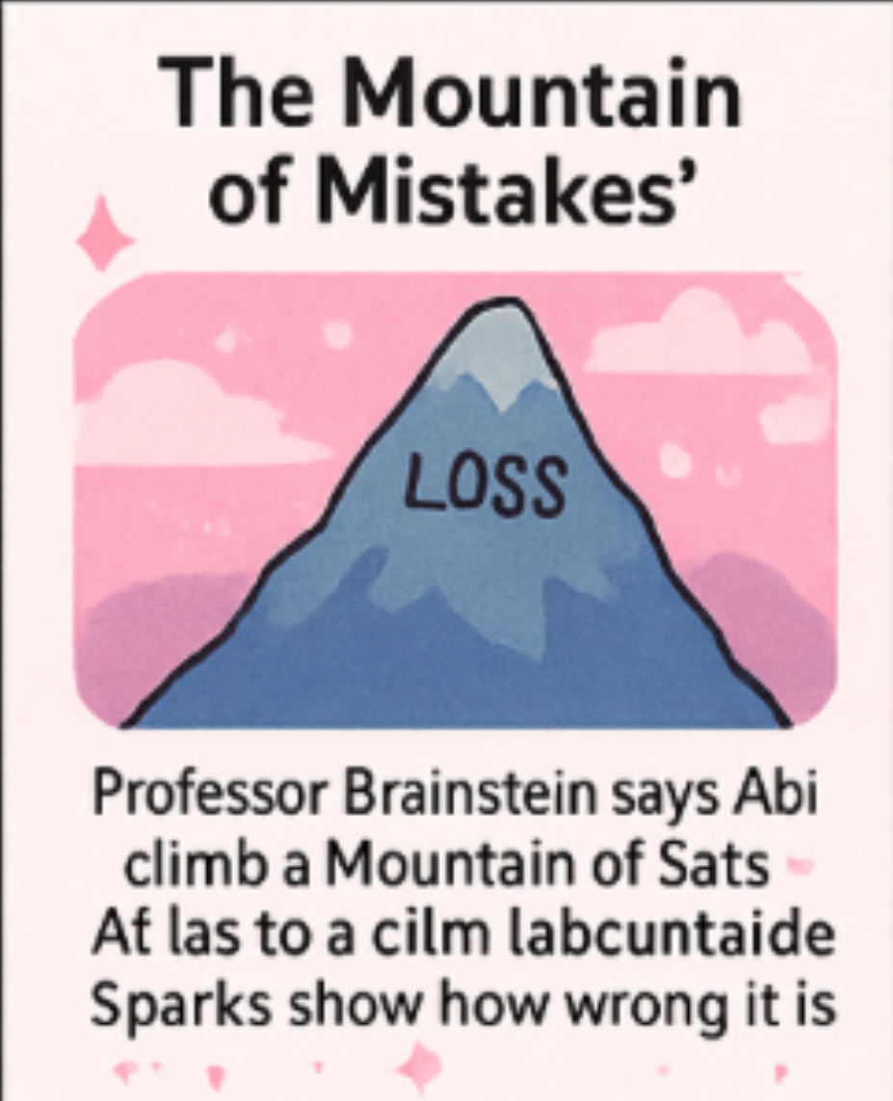
The Mountain of mistakes (loss function)
Text: Professor Brainstein tells me that learning is like climbing down a Mountain of Mistakes. At the top, I make terrible guesses! My goal is to go down the mountain by reducing my mistakes one step at a time.
Concept Introduced:
The loss function measures how bad the computer’s guesses are.
The “mountain” is shaped by this loss, high loss = bad guesses, low loss = good ones.

Slide 4
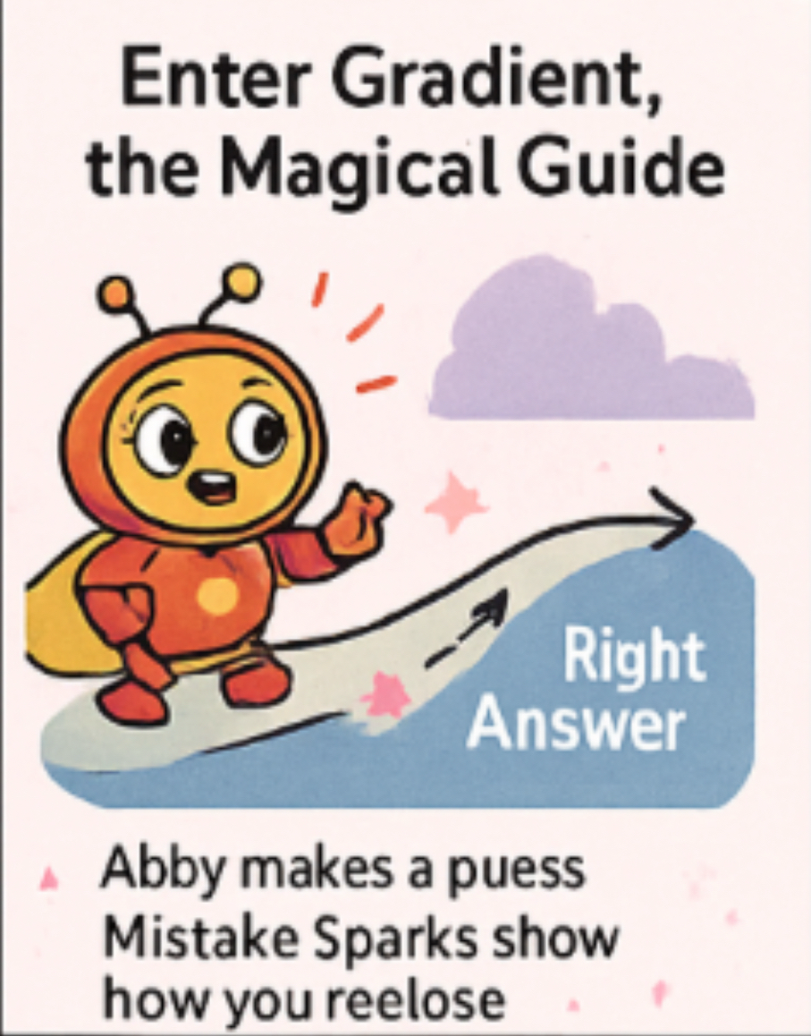
Enter gradient – the magical learning guide
Text: This is Gradient, my glowing helper. Gradient shows me the steepest direction to step in to reduce my mistakes. It’s like he’s saying, “Step THIS way to fix your guess a little!”
Concept Introduced:
The Gradient is the direction where the loss decreases fastest
It tells the model which way to adjust its weights and biases

Slide 5
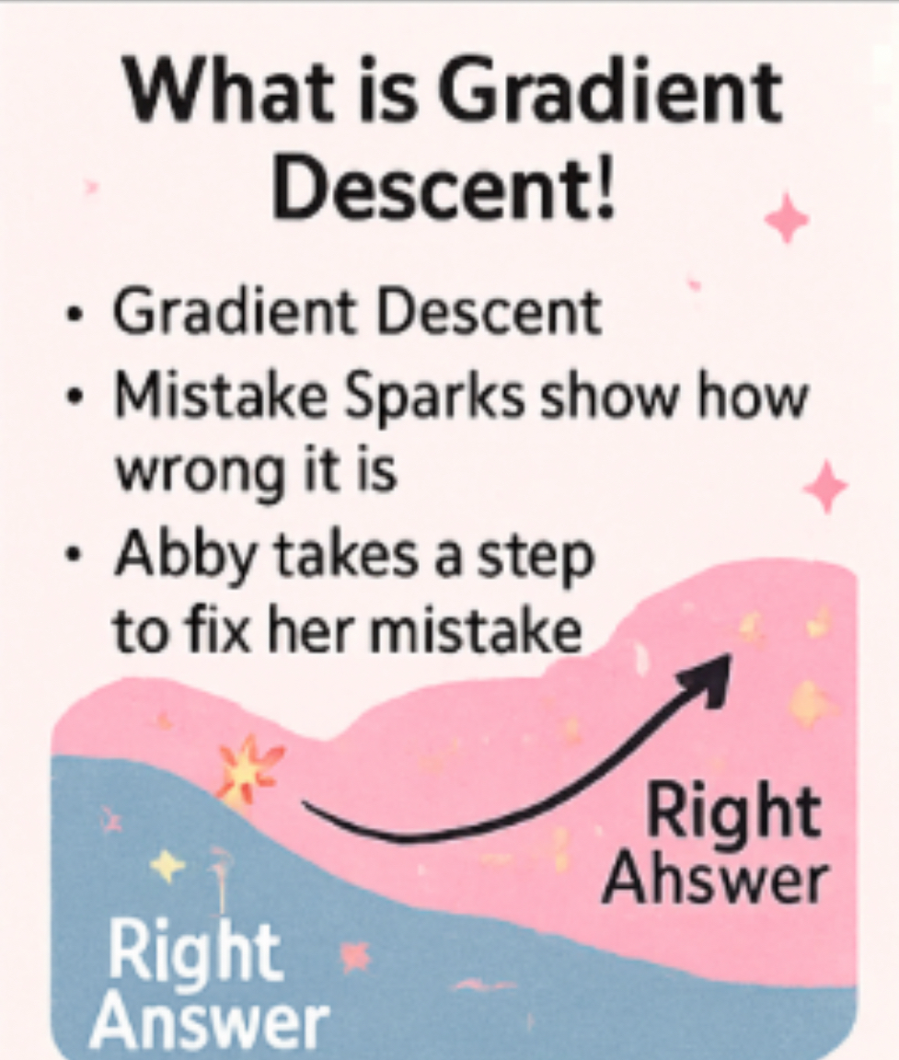
Tiny steps – the learning rate
Text: Gradient days I shouldn’t run — I need to take tiny, careful steps! If I step too big, I’ll trip and make worse guesses. If I step too small, I’ll take forever to learn.
Concept introduced:
The learning rate controls how big the model’s changes are
Too high = skipping over the right answer
Too low = slow learning or getting stuck

Slide 6
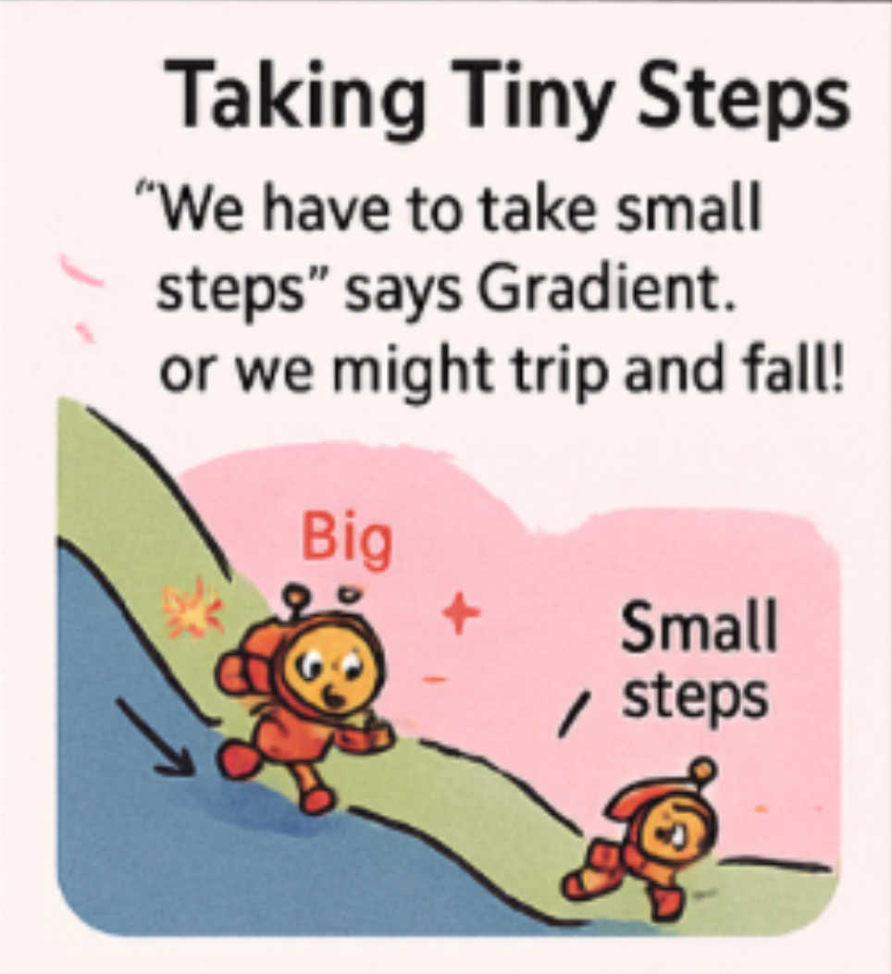
Abby’s brain – adjusting weights
Text: Inside my robot brain, I have lots of little dials called weights. Gradient Descent helps me turn them slightly after each guess to get better results!
Concept Introduced:
Weights are what the model adjusts during learning
Gradient Descent helps update these weights by calculating how wrong the output is and correcting it

Slide 7
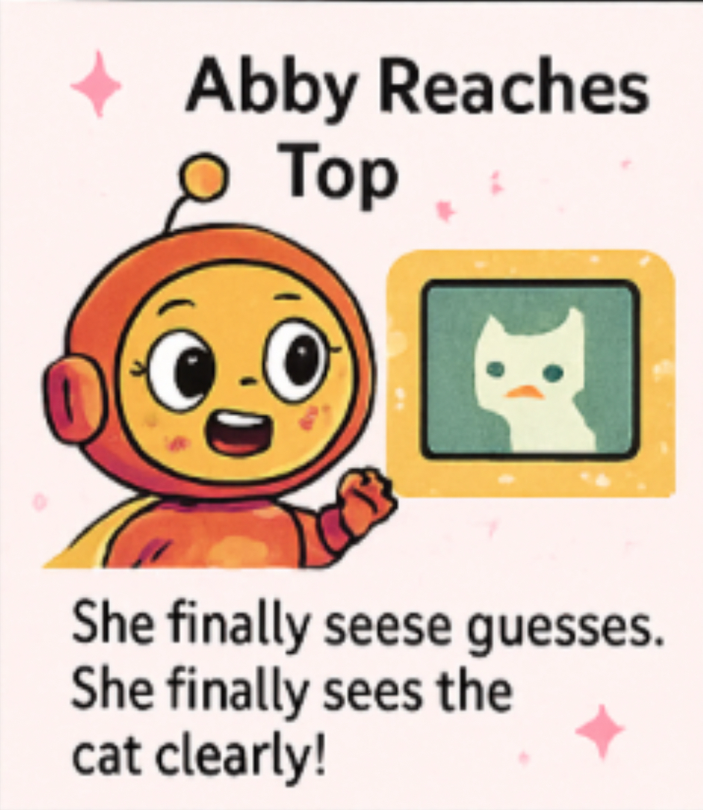
Getting smarter – reaching the bottom
Text: After lots of tiny steps with Gradient, my guesses get better and better, the Mistake Sparks get smaller. Finally, I reach the bottom of the mountain — I can now spot a cat every time!
Concept Introduced:
When the loss is small and predictions are good, the model has “converged” (learned well).
This is the goal of Gradient Descent!

Slide 8
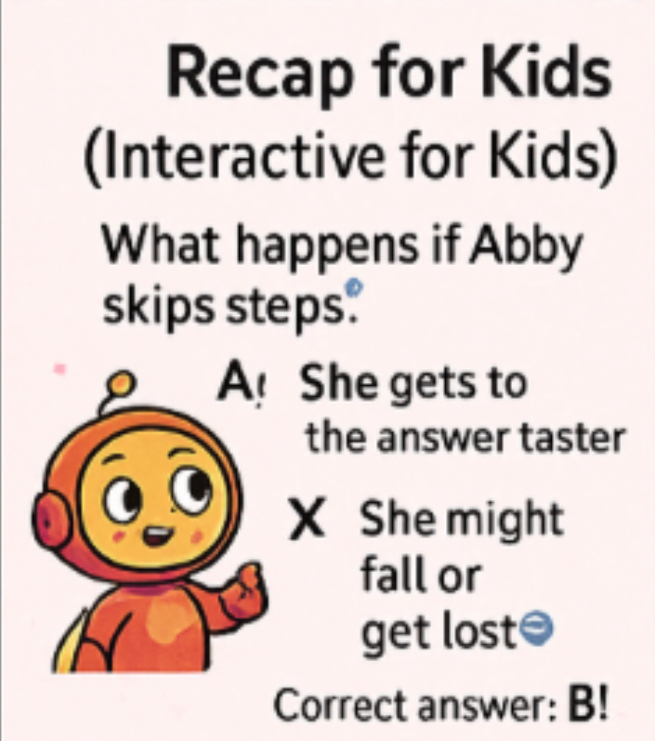
Recap (interactive for kids)
What does Gradient Descent help Abby do?
Make random guesses forever
Fix mistakes step by step ✅
Learn only with big jumps
Answer: B!
Fun Tip: Think of Gradient Descent like playing a video game and leveling up each time you fix your guess!

Slide 9

Real-life use examples
Where do we use Gradient Descent?
Teaching computers to understand voices (like Alexa!)
Helping self-driving cars stay on the road
Learning to write captions for photos

Slide 10
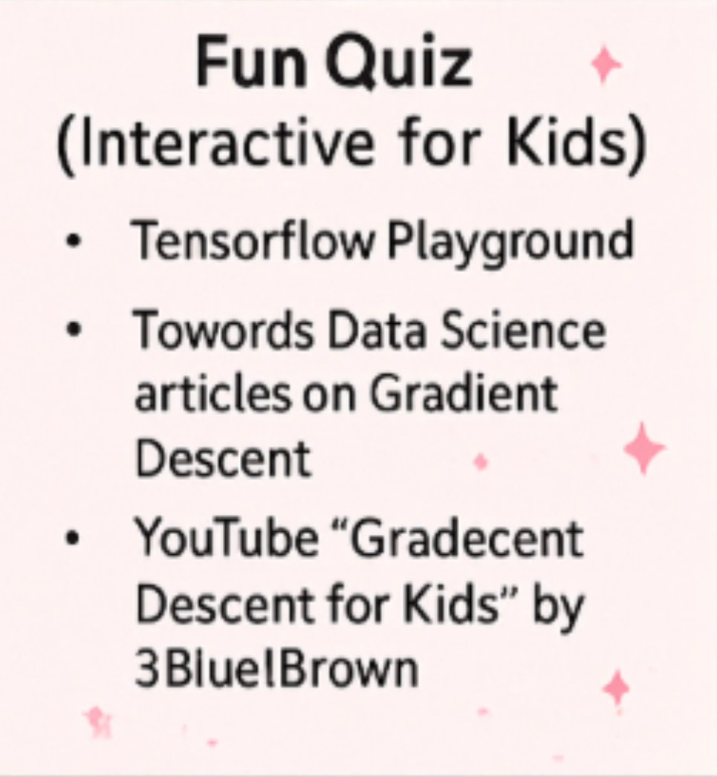
Sources/credits
https://playground.tensorflow.org/
https://towardsdatascience.com/gradient-descent-unraveled-3274c895d12d-2/
https://towardsdatascience.com/linear-regression-and-gradient-descent-for-absolute-beginners-eef9574eadb0/
https://www.youtube.com/watch?v=IHZwWFHWa-w

